Slide 1

ECE382
Lesson 28
1

Slide 2
What is Capture/Compare?
Capture
  When a pin changes value, the time is recorded and an interrupt occurs. The interrupt service routine can then operate on that data and reset the time for the next event
Compare
  Used to generate a signal. When a timer reaches a predefined value, an interrupt occurs and a pin’s state is changed

Slide 3
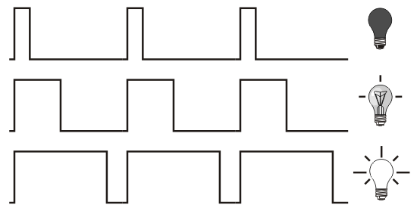
Pulse Width Modulation (PWM)
Commonly used for digital-to-analog
  Not very high performance, but cheap/easy
  Used for a lot of things like LED, buzzers, motors, etc
Duty cycle is a reference to what percentage of time the signal is high during a period
period

Slide 4
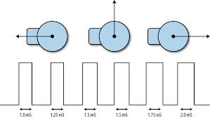
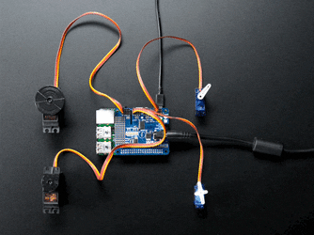
Toy Servo Control
PWM is commonly used in the RC toy world
  We will do this in lab 4
Most high performance servos use a serial/packet interface. We will talk more about this then we talk about serial communications

Slide 5
PWM Setup Tasks
Set I/O direction for output
  MUX PWM
Set period
Set on time
Enable PWM mode on timer
Config / Start timer

Slide 6
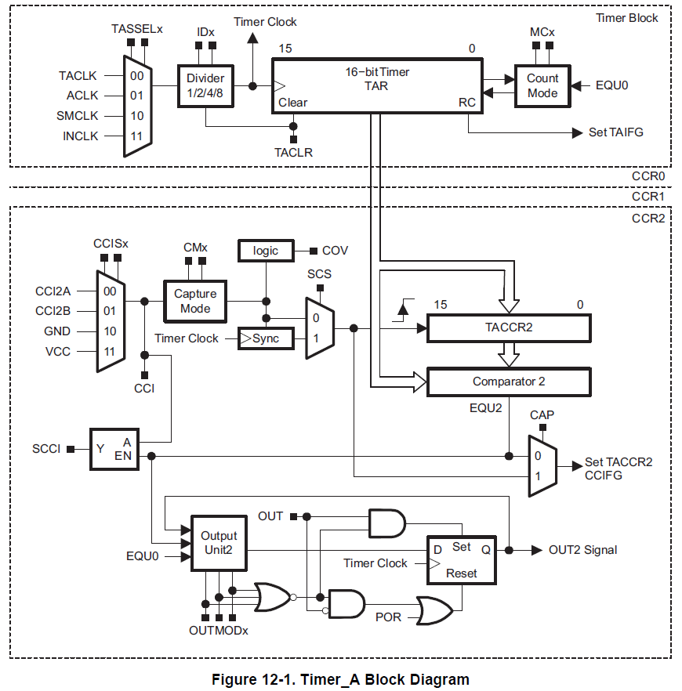
Timer Block Diagram
1
2
3
0
clks
cnts
Capture / Compare
4
5
Family User Guide pp 357

Slide 7
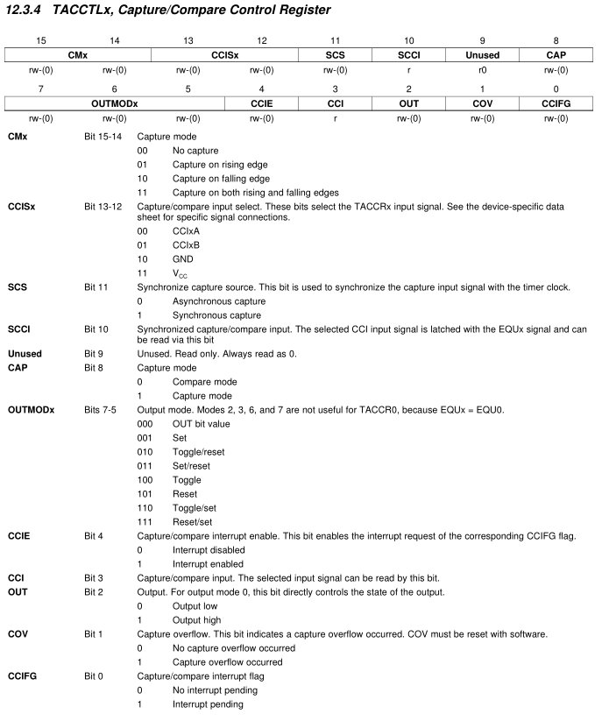
Backup Slides
Family User Guide pp 372

Slide 8
Timer Block Diagram
CAP
Family User Guide pp 357

Slide 9
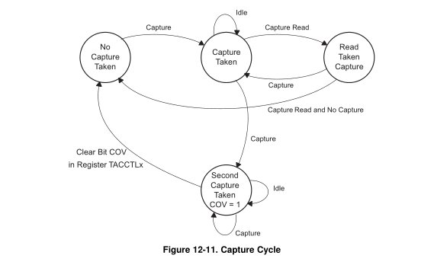
Input Capture
Capture mode is selected when the CAP bit in TACCTL is set to 1. It's used to record time events. It can be used for:
  Event detection
  Event counting
  Pulse-width measurement ***
  Frequency measurement
Each TACCRx has two possible capture pins - CCIxA and CCIxB. The one being monitored is selectable by software.
If a capture occurs:
  The TAR value is copied into the TACCRx register
  The interrupt flag CCIFG is set
Family User Guide pp 363

Slide 10
Timer Block Diagram
CCISx
CMx
SCS
We have seen this before, but in a different context
These all have standard definitions like CCIS_1
CCIFG
Family User Guide pp 357

Slide 11
Backup Slides
Family User Guide pp 372

Slide 12
Backup Slides
Family User Guide pp 372

Slide 13
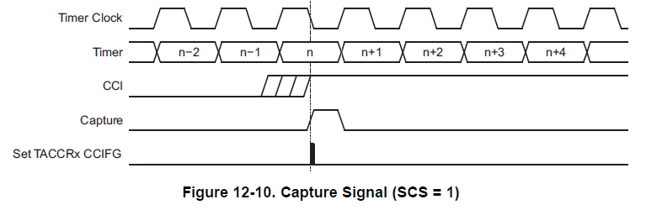
Input Capture
The input signal level can be read at any time via the CCI bit. MSP430x2xx family devices may have different signals connected to CCIxA and CCIxB. See the device-specific data sheet for the connections of these signals.
Same value as input pin
Family User Guide pp 362

Slide 14
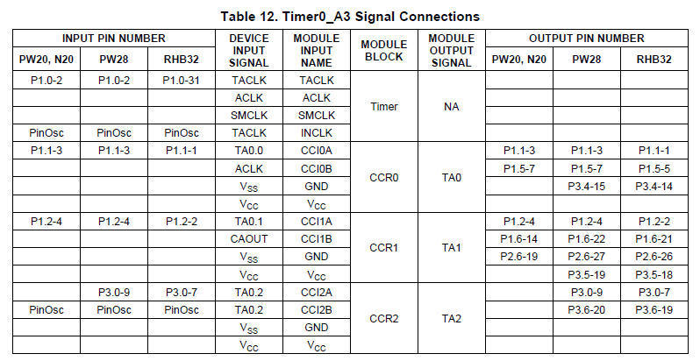
Input Capture
The input signal level can be read at any time via the CCI bit. MSP430x2xx family devices may have different signals connected to CCIxA and CCIxB. See the device-specific data sheet for the connections of these signals.
Device Specific pp 16

Slide 15
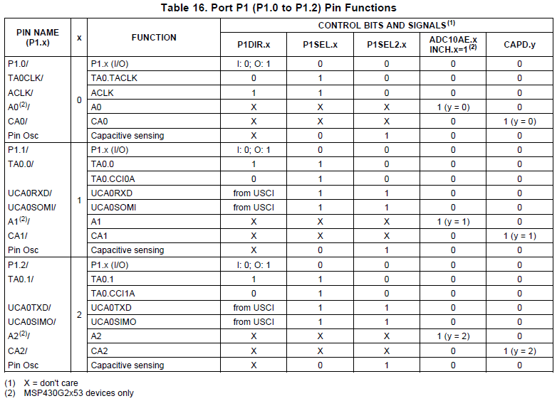
Input Capture
TA_0 CC0
TA_0 CC1
Device Specific pp 43

Slide 16
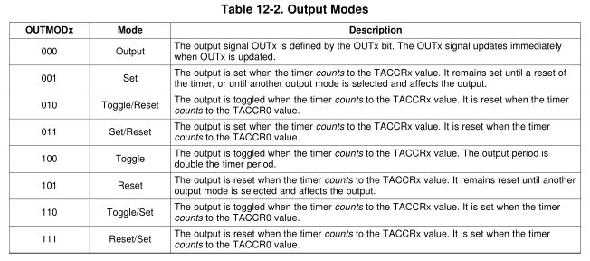
Output Compare
Compare mode is selected when the CAP bit in TACCTL is set to 0
Same Timer Modes: MCx
Count up to TACCRO. Now adding two new registers: TA0CCR1 and TA0CCR2
Mcx | Mode | Description
00 | Stop | The timer is halted. MC_0
01 | Up | The timer repeatedly counts from zero to the value of TACCR0. MC_1
10 | Continuous | The timer repeatedly counts from zero to 0FFFFh. MC_2
11 | Up/down | The timer repeatedly counts from zero up to the value of TACCR0 and back down to zero. MC_3

Slide 17
Timer Block Diagram
CCR0-2
Remember, there are 3 CC per timer
Family User Guide pp 357

Slide 18
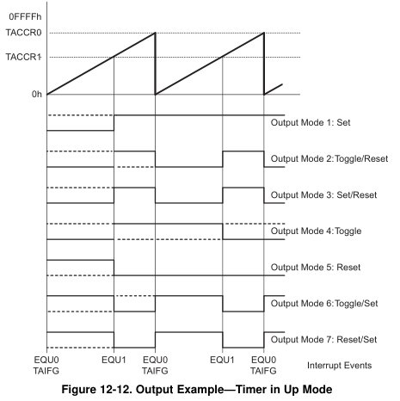
Output Compare
You will likely use mode 3 & 7 for PWM

Slide 19
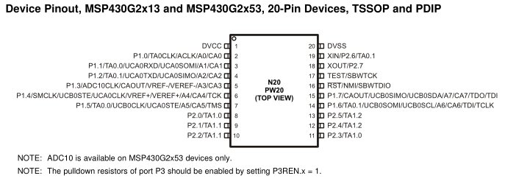
Ports?
Pin 3 TA0.0 P1.1
Pin 4 TA0.1 P1.2
Pin 8 TA1.0 P2.0
Pin 9 TA1.1 P2.1

Slide 20
PWM Setup Tasks
PxDIR
Set I/O direction for output
  MUX PWM
Set period
Set on time
Enable PWM mode on timer
Config / Start timer
PxSEL, PxSEL2
TAxCCRx
TAxCCTLx
TAxCTL

Slide 21
Example w/o Interrupts
#include <msp430.h>
int main(void)
{
WDTCTL = WDTPW|WDTHOLD; // stop the watchdog timer
P1DIR |= BIT2; // TA0CCR1 on P1.2
P1SEL |= BIT2; // TA0CCR1 on P1.2
TA0CTL &= ~MC1|MC0; // stop timer A0
TA0CTL |= TACLR; // clear timer A0
TA0CTL |= TASSEL1; // configure for SMCLK
TA0CCR0 = 100; // set signal period to 100 clock cycles (~100 microseconds)
TA0CCR1 = 25; // set duty cycle to 25/100 (25%)
TA0CCTL1 |= OUTMOD_7; // set TACCTL1 to Reset / Set mode
TA0CTL |= MC0; // count up
while (1) {
__delay_cycles(1000000);
TA0CCR1 = 50; // set duty cycle to 50/100 (50%)
__delay_cycles(1000000);
TA0CCR1 = 75; // set duty cycle to 75/100 (75%)
__delay_cycles(1000000);
TA0CCR1 = 100; // set duty cycle to 100/100 (100%)
__delay_cycles(1000000);
TA0CCR1 = 25; // set duty cycle to 25/100 (25%)
}
return 0;
}

Slide 22
Example with Interrupt
void main(void){
WDTCTL = WDTPW|WDTHOLD;// stop the watchdog timer
P2DIR |= BIT1; // TA1CCR1 on P2.1
P2SEL |= BIT1; // TA1CCR1 on P2.1
P2OUT &= ~BIT1;
TA1CTL |= TASSEL_2|MC_1|ID_0; // configure for SMCLK
P1DIR |= BIT0; // use LED to indicate duty cycle has toggled
P1REN |= BIT3; // setup button
P1OUT |= BIT3;
TA1CCR0 = 1000; // set signal period to 1000 clock cycles (~1 msec for 1MHz)
TA1CCR1 = 250; // set duty cycle to 250/1000 (25%)
TA1CCTL0 |= CCIE; // enable CC interrupts
TA1CCTL1 |= OUTMOD_7|CCIE; // set TACCTL1 to Set / Reset mode//enable CC interrupts
TA1CCTL1 &= ~CCIFG; //clear capture compare interrupt flag
_enable_interrupt();
uint8_t index = 0;
uint16_t duty_cycles[] = {1000, 750, 500, 250}; // 1000/1000 (100%), 75%, 50%, 25%
while (1) {
while (P1IN & BIT3); // Polling: every time the button is pushed, toggle the duty cycle
__delay_cycles(1000000);
TA1CCR1 = duty_cycles[index++]; // set duty cycle
index %= 4; // wrap index number to 0-3
}
}

Slide 23
Example with Interrupt
#pragma vector = TIMER1_A0_VECTOR
__interrupt void captureCompareInt (void) {
P1OUT |= BIT0; //Turn on LED
TA1CCTL1 &= ~CCIFG; //clear capture compare interrupt flag
}
#pragma vector = TIMER1_A1_VECTOR
__interrupt void captureCompareInt2 (void) {
P1OUT &= ~BIT0; //Turn off LED
TA1CCTL1 &= ~CCIFG; //clear capture compare interrupt flag
}

Slide 24
BACKUPS

Slide 25

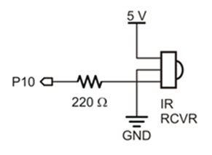
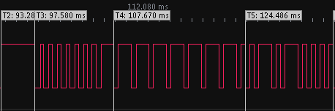
Overview
Lesson Outline
  Capture and Compare
3.3V
MSP430
By timing how wide these pulses are, we can translate the pulses into 0’s or 1’s (binary) and understand what the remote is telling us

